Slide 1




Comic books catalogue management system
PRESENTED BY :
NAME : S.AARTHI
ROLL NO : ECA2301
REG NO : 8115U23EC001
DEPARTMENT : ECE
SEMESTER : 2nd

Slide 2

CONTENT
Introduction
Objectives
Technology used
Workflow
Module completion
Program
Pros and Cons

Slide 3


Introduction
Introducing a comic books catalogue management system! This system is designed to efficiently organize, categorize, and track your comic book collection.
With features like barcode scanning, customizable tags, and detailed descriptions, managing your collection has never been easier.
Say goodbye to lost issues and hello to a well-organized, easily accessible comic book library!

Slide 4

Objective
The objective of implementing a comic books catalogue management system is to streamline the organization and tracking of comic book collections.
This system aims to provide users with efficient tools to categorize, search, and manage their comics, ultimately saving time and ensuring easy access to their entire collection.

Slide 5


Technology used :
Pandas and NumPy for data handling.
Matplotlib and Seaborn for visualizations.
Flask or Django to build a web-based Application
(if needed).

Slide 6
WORKFLOW
Requirements Gathering : Collect needs from stakeholders.
2. Design : Plan system architecture and user interface.
3. Frontend Development : Create the user interface using HTML, CSS, and JavaScript.
4. Backend Development : Implement backend logic with Python and a web framework.
5. Database Setup : Establish a database using PostgreSQL or MySQL.
6. Integration : Integrate third-party services as needed.
7. Testing : Perform unit and integration testing.
8. Deployment : Deploy the system on-premises or on a cloud platform.
9. User Training : Train users on system usage.
10. Documentation : Create user and technical documentation for reference.

Slide 7
PROS :
CONS :
1.Efficiency
2.Accesibility
3.Real time tracking
4.Integration
5.Analytics
1.Initial Investment
2.Technical challenges
3.User adoption
4.Data security
5.Customization

Slide 8
Module completion :
1. User Authentication : Secure access to the system.
2. Book Management : Add, edit, and delete books.
3.Inventory Management : Track book availability.
4. Loan Management : Monitor loaned books and due dates.
5. Reporting : Generate insights on book usage.
6. Search and Filter : Quickly find specific books.
7. Integration with Online Bookstores : Purchase books within the system.
8. User Role : Define roles for administrators, faculty, and students.
9. Notifications : Alert users about overdue books or system updates.
10.Analytics : Analyze data trends for resource optimization.
11. Settings : Customize system preferences.
12. Documentation : Provide user and technical guides.

Slide 9
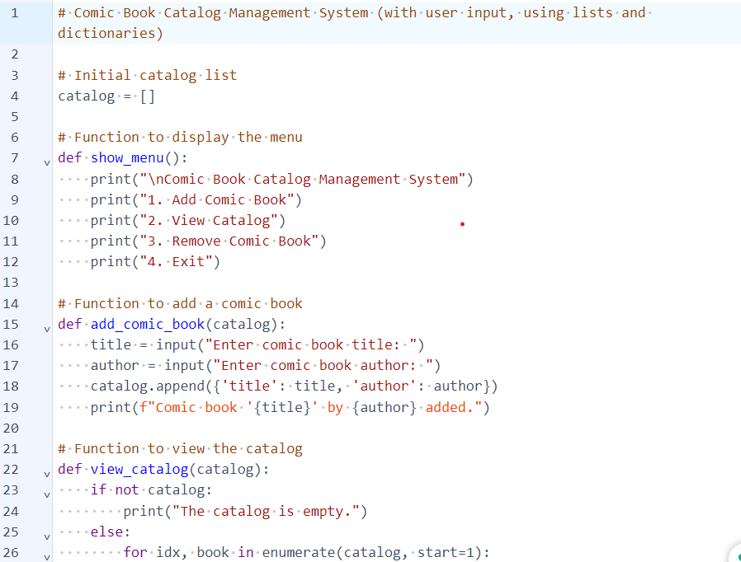
program

Slide 10
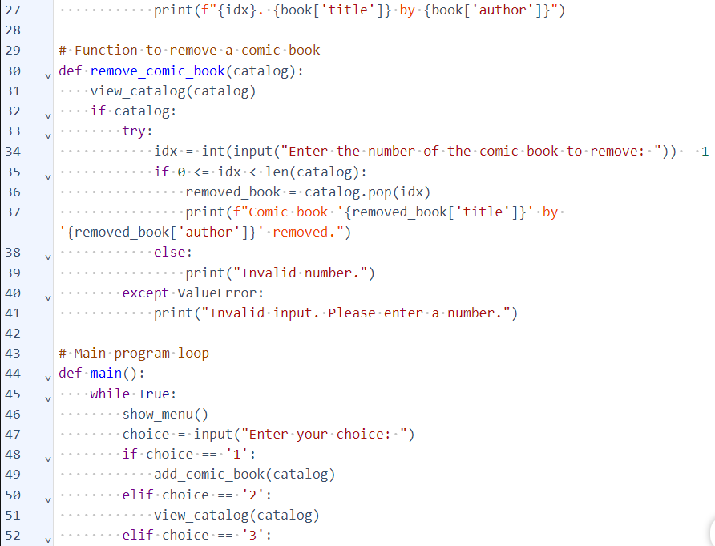
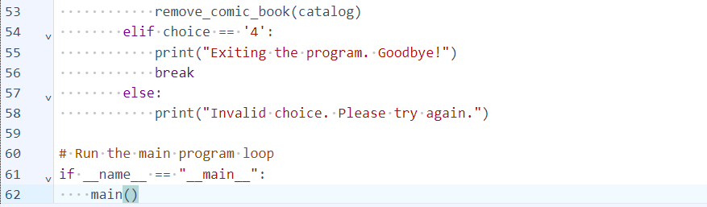

Slide 11
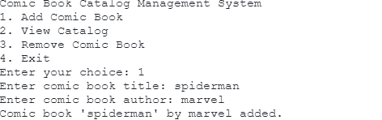
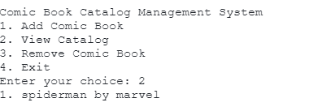
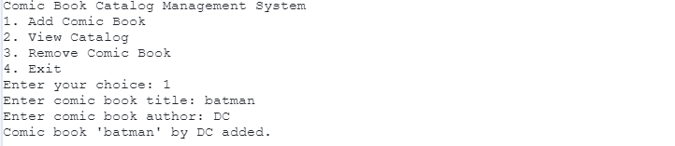
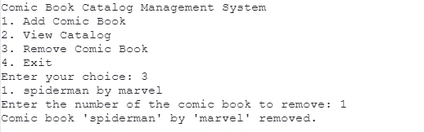
output

Slide 12
Thank you!

